Slide 1
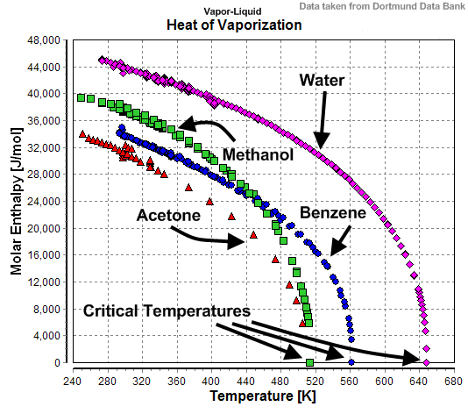
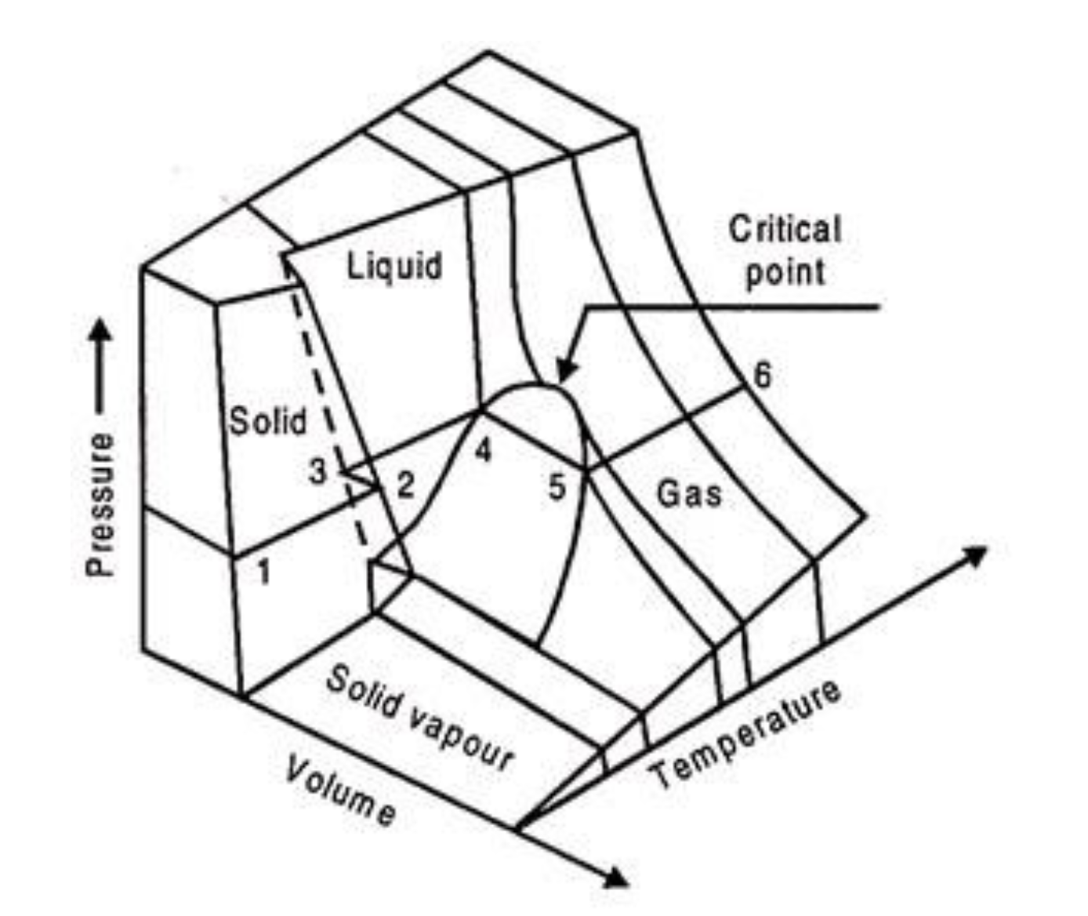
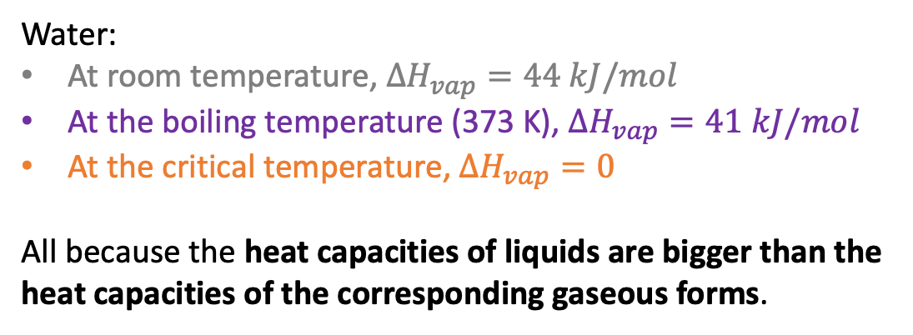
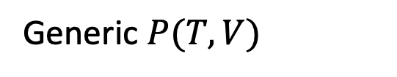
What we learned this week …
How $∆H_{vap}$ goes to zero at the critical temperature
Water:
At room temperature, $∆H_{vap}=44 kJ/mol$
At the boiling temperature (373 K), $∆H_{vap}=41 kJ/mol$
At the critical temperature, $∆H_{vap}=0$
All because the heat capacities of liquids are bigger than the heat capacities of the corresponding gaseous forms.
Is there a molecular perspective on this?
Generic $P(T,V)$

Slide 2
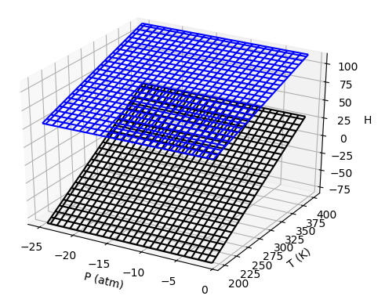
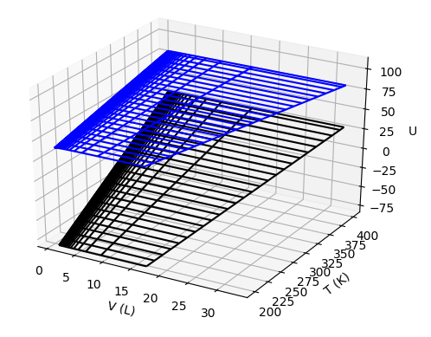
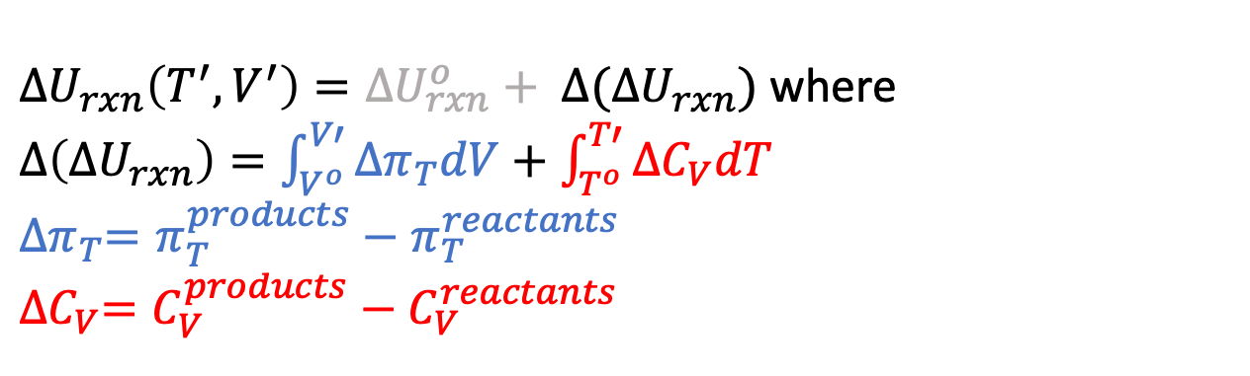
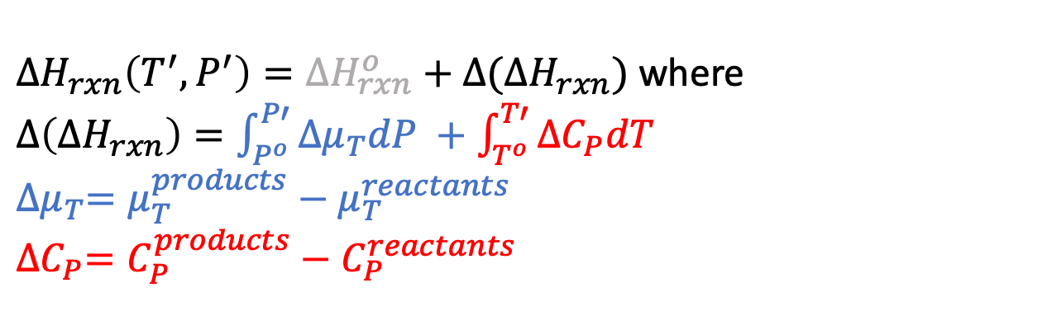
What we learned this week …
How to cruise through state space to get $∆H_{rxn}$ (and $∆U_{rxn}$) at non-standard conditions via a generalized Kirchoff’s Law:
$∆H_{rxn}\left(T^{′},P^{′}\right)=∆H_{rxn}^{o}+$ $∆(∆H_{rxn})$ where
$∆\left(∆H_{rxn}\right)=\int_{P^{o}}^{P′}{{∆μ}_{T}dP +\int_{T^{o}}^{T′}{{∆C}_{P}dT}}$
${∆μ}_{T}=μ_{T}^{products}−μ_{T}^{reactants}$
$${∆C}_{P}=C_{P}^{products}−C_{P}^{reactants}$$
$∆U_{rxn}\left(T^{′},V^{′}\right)=∆U_{rxn}^{o}+ ∆(∆U_{rxn})$ where
$∆\left(∆U_{rxn}\right)=\int_{V^{o}}^{V′}{{∆π}_{T}dV}+\int_{T^{o}}^{T′}{{∆C}_{V}dT}$
$${∆π}_{T}=π_{T}^{products}−π_{T}^{reactants}$$
$${∆C}_{V}=C_{V}^{products}−C_{V}^{reactants}$$

Slide 3
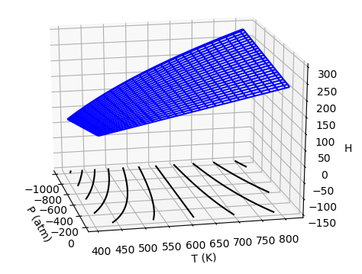
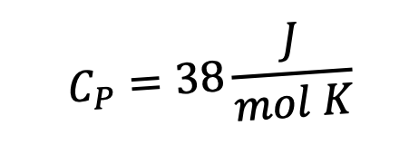

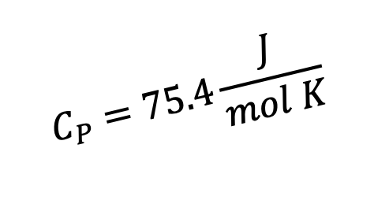


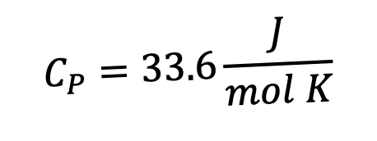
Problems
$$C_{P}=33.6\frac{J}{mol K}$$
$$44.0\frac{kJ}{mol}$$
$$C_{P}=75.4\frac{J}{mol K}$$
H
$$50.0\frac{kJ}{mol}$$
$$6.0\frac{kJ}{mol}$$
$$C_{P}=38\frac{J}{mol K}$$
T

